Slide 1

CSEG312-01 Project
Topic : KAGGLE · PLAYGROUND PREDICTION COMPETITION
-Classification with an Academic Success Dataset

Slide 2
Dataset :
The dataset for this competition (both train and test) was generated from a deep learning model trained on the Predict Students' Dropout and Academic Success dataset.
Training dataset is csv file with 76518 rows × 37 columns. ‘Target’ is the categorical target.
Test dataset is csv file with 51012 rows × 36 columns.

Slide 3
Evaluation :
Submissions are evaluated using the accuracy score.

Slide 4
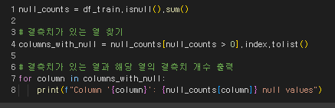
EDA :
Find null values in dataset

Slide 5
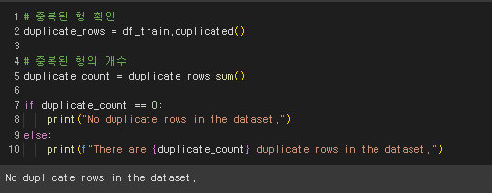
EDA :
Find duplicate rows in dataset

Slide 6
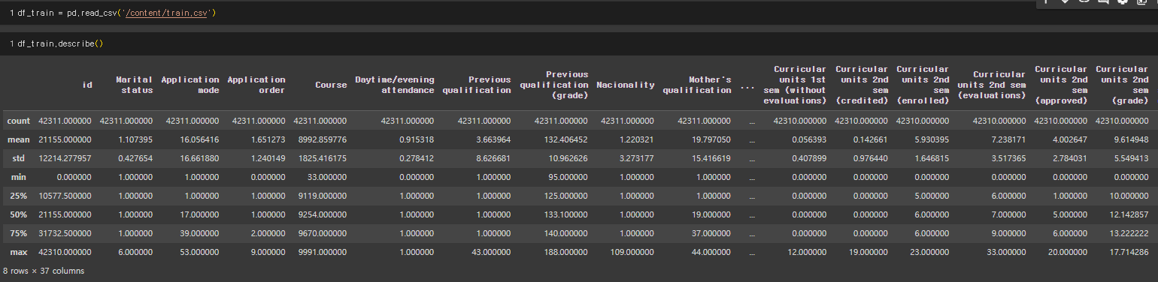
EDA :
Summary of dataset

Slide 7
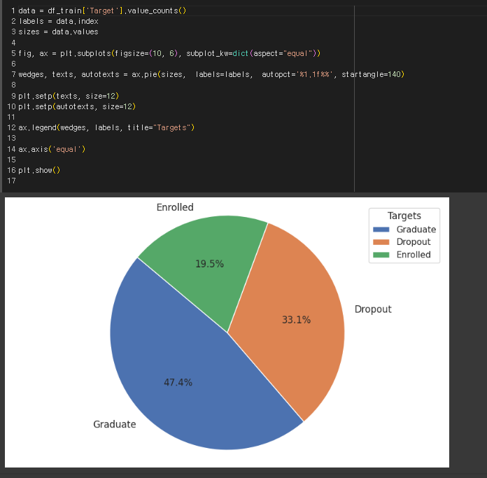
EDA :
Target Value Distribuition

Slide 8
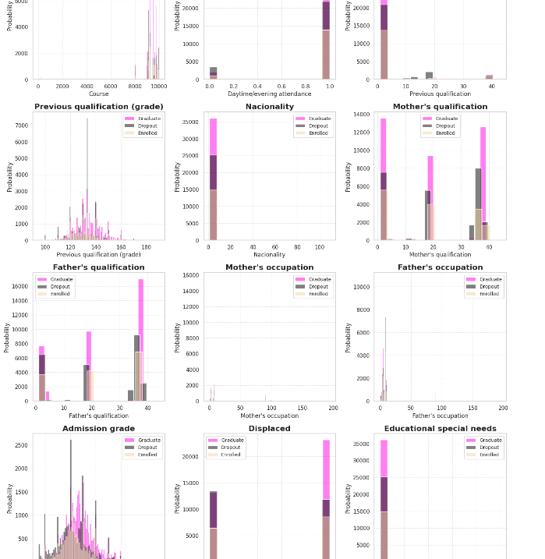
EDA :
Target Value with other Columns

Slide 9
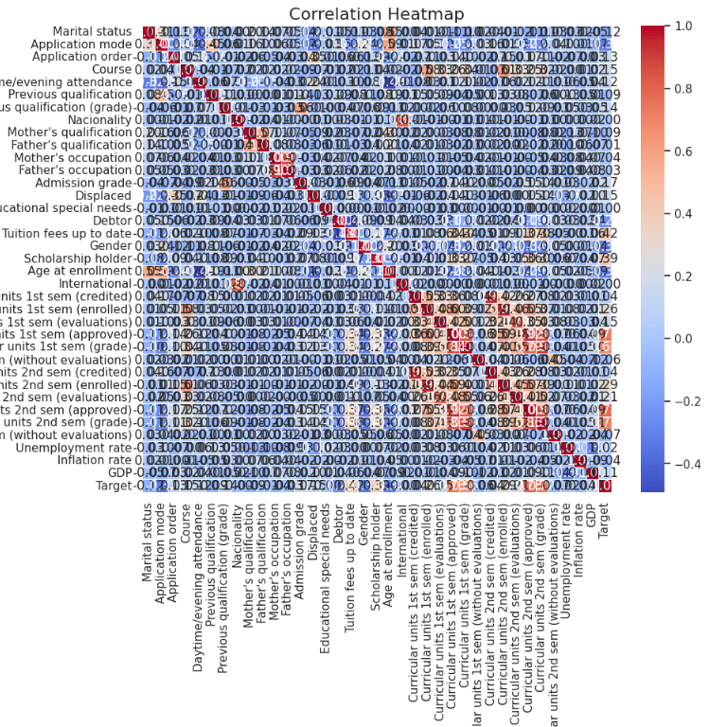
EDA :
Correlation heatmap

Slide 10
Modeling :
Use 4 model (RandomForestClassifier, CatBoostClassifier, XGBClassifier, LGBMClassifier) to get best accuracy score.
Find best model and get submission.csv
Ensemble each model’s prediction and get ensemble_submission.csv

Slide 11
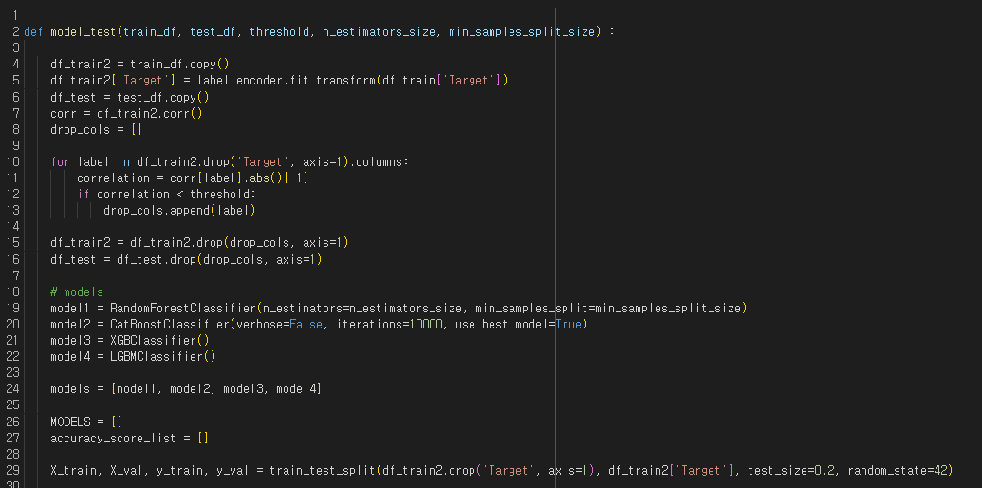
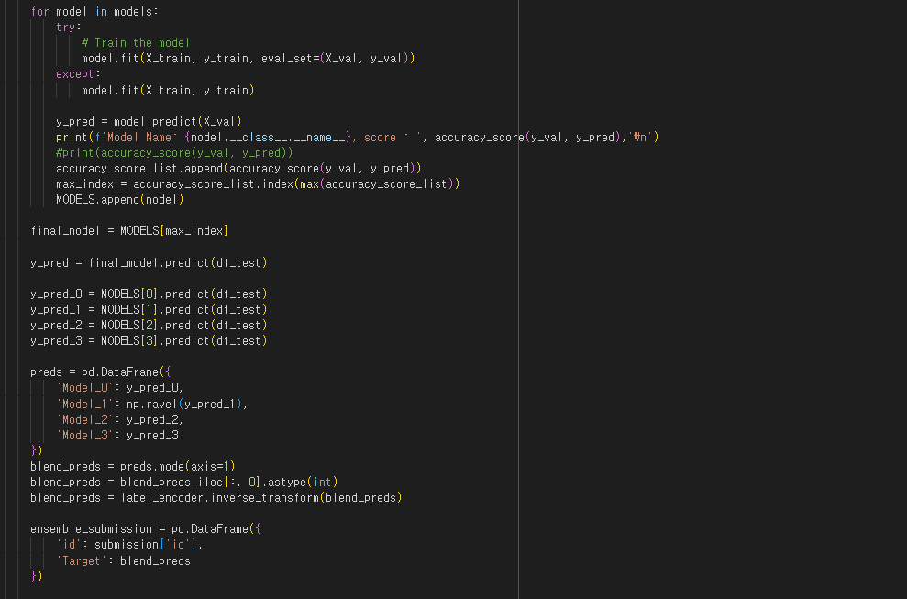
Modeling :

Slide 12
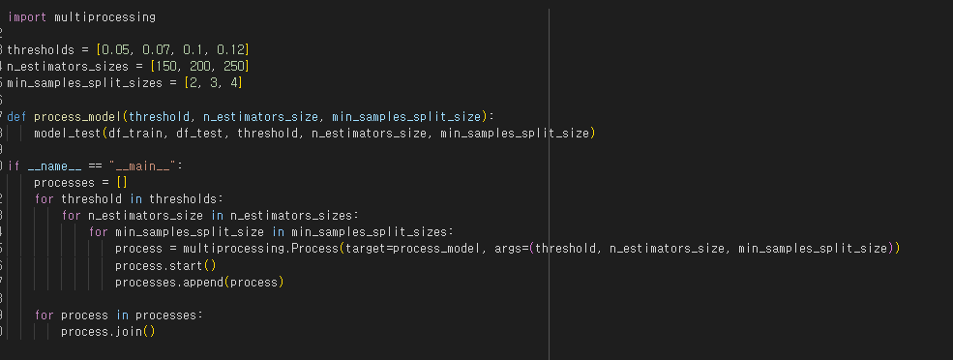
Parameter Tuning :
Set variable thresholds to drop columns.
Set variable parameters for model.
Use multiprocessing to get highest accuracy score.

Slide 13
Result :
 | 150 | 150 | 150 | 200 | 200 | 200 | 250 | 250 | 250
Random Forest | 2 | 3 | 4 | 2 | 3 | 4 | 2 | 3 | 4
0.05 | 0.82632 | 0.82514 | 0.82756 | 0.82763 | 0.82671 | 0.82789 | 0.82639 | 0.82684 | 0.82671
0.07 | 0.82482 | 0.8271 | 0.82691 | 0.82573 | 0.8275 | 0.82861 | 0.82567 | 0.82665 | 0.82691
0.1 | 0.82488 | 0.82521 | 0.82573 | 0.82541 | 0.82678 | 0.8271 | 0.82632 | 0.82678 | 0.82737
0.12 | 0.82194 | 0.82449 | 0.82442 | 0.82181 | 0.82338 | 0.82344 | 0.82273 | 0.82312 | 0.82397
 | 0.05 | 0.07 | 0.1 | 0.12
CatBoost | 0.83344 | 0.83227 | 0.832 | 0.83076
XGB | 0.83031 | 0.83063 | 0.82933 | 0.82867
LGBM | 0.83057 | 0.83063 | 0.82919 | 0.829

Slide 14
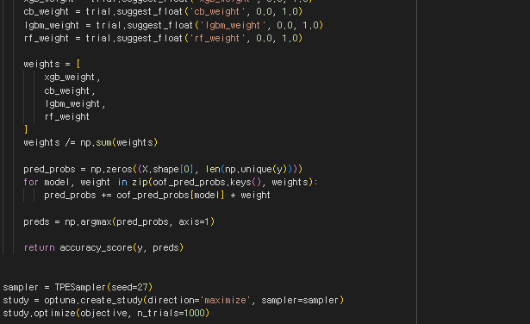

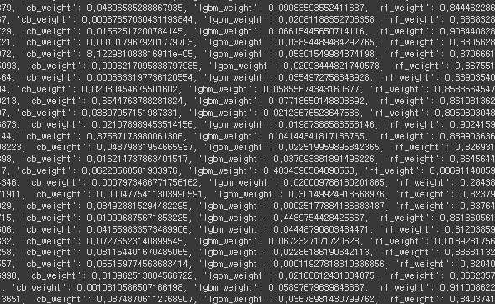

Ensemble Enhancement :
-Use optuna library to find best weights

Slide 15
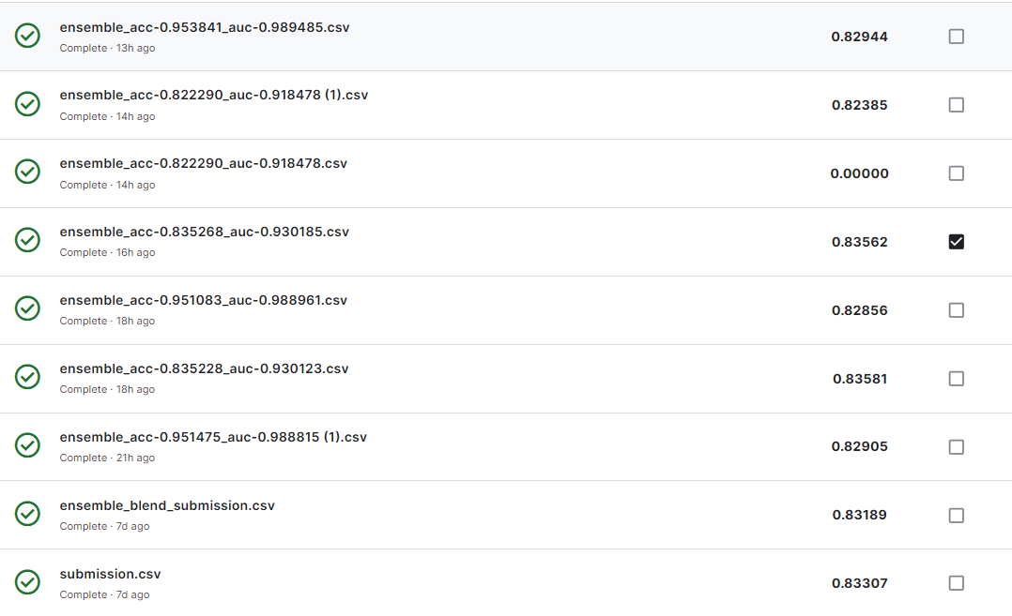
Results :
-Using the best model is better than a same-weight ensemble.
-Compared to the results of ensemble tuning with original data and processed data, using the original data model yields better results.

Slide 16

Thanks

